Slide 1
An Introduction to Django
By Joe Ekstrom & Jason Densmore

Slide 2


Slide 3
What is Django?
Django is a Python web framework that allows developers to quickly and effectively build secure and maintainable websites.
Built by developers, for developers.
Django is free and open source, with great up to date documentation, and a thriving active community
Django takes care of many of the roadblocks web development endures, in order to let you focus more on writing the app, and less on building it from scratch.

Slide 4
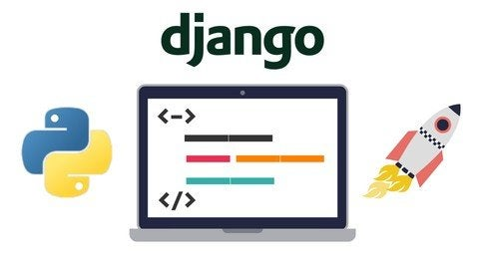
Django helps you write software that is…
Complete
Versatile
Secure
Scalable
Maintainable
Portable
Notes:
Complete
Django follows the “Batteries Included” philosophy, where it includes everything you need “out of the box”
Versatile
With Django, it will enable to build almost any type of website, from social networks, to content management systems and wikis
It works with any client-side framework, and can deliver content in almost any format
HTML
RSS
JSON
XML
Etc.
On the inside, it provides options for almost any additional functionality you may need, like databases and templating engines. It can be extended to use other components if needed.
Secure
Django uses a component-based-“shared nothing” architecture (each part of the architecture is independent of the others, and can hence be replaced or changed if needed).
Having clear separation between the different parts means that it can scale for increased traffic by adding hardware at any level:
caching servers
database servers
application servers.
Some of the busiest sites have successfully scaled Django to meet their demands
Instagram
Discus
Maintainable
Django code is written using design principles and patterns that encourage the creation of maintainable
In particular, it makes use of the Don’t repeat yourself (DRY) principle so there is no unnecessary duplication, reducing the amount of code.
Django also promotes the grouping of related functionality into reusable “applications” and, at a lower level, groups related code into modules (along the lines of the Model View Controller MVC pattern
Portable
Django is written in Python, which runs on many platforms. That means that you are not tied to any particular server platform, and run your applications on many flavours of Linux, Windows, and Mac OS X.
Django is also well-supported by many web hosting providers, who often provide specific infrastructure and documentation for hosting Django sites

Slide 5
What’s do we get “out of the box”?

Slide 6
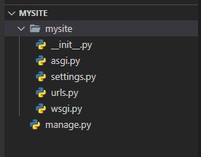
What we are given “Out of the box”
The container
Root directory of the project
Its name is used as a Reference point across the entire project (e,g. mysite.url)
manage.py
Method to interact with Django via CMD
__init__.py
Lets python know the directory should be considered a python package
settings.py
Settings/configuration for the project
urls.py
URL declarations for the project
asgi.py
Entry point for ASGI-compatible web servers
wsgi.py
Entry point for WSGI-compatible web servers
Notes:
When you first create a Django Project, you are given the following…
The Container
In our case ‘mysite’, is the root directory for the project.
Its name is used as a reference point across the entire project
For example mysite.urls
manage.py
A command line utility that lets you interact with a Django project in various ways
You’ll see an example of this later on in the demo.
__init__.py file
An empty file that tells python that this directory should be considered a Python package.
settings.py
Settings or in other words the configuration file for the project
Things like middleware and databases are set up here, more on this later on.
urls.py
URL declarations for the project are set here
This is where you set up your site navigation.
asgi.py
exposes the ASGI callable as a module-level variable named ``application``.
An entry-point for ASGI-compatible web servers to serve your project.
wsgi.py
exposes the WSGI callable as a module-level variable named ``application``
An entry-point for WSGI-compatible web servers to serve your project.
Fun facts
WSGI (Web server gateway interface) provides a standard for synchronous Python apps.
Where ASGI (Asynchronous Server Gateway Interface) provides a standard for both asynchronous and synchronous Web Servers, Frameworks and Applications.

Slide 7
Lets run it!
Now that we have a project created lets see what Django gave us.
Run this command in CMD.
And after a few simple commands we have this………..

Slide 8
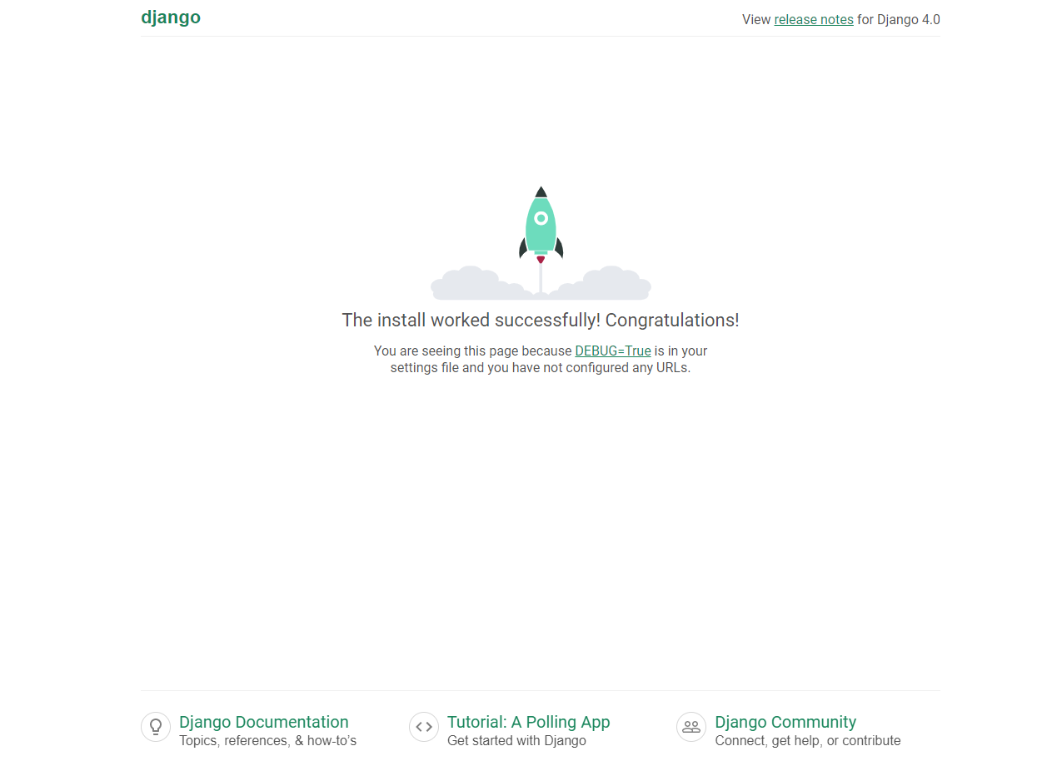
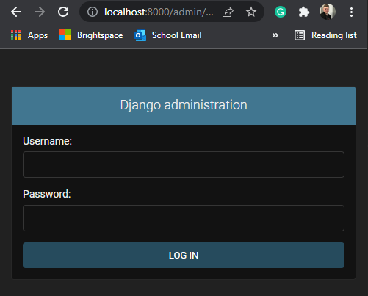
A fully equipped Website
Notes:
Aside from the simple homepage with a cool little animation
The starting project for Django comes equipped with full site administrator functionality
More on this later.

Slide 9
Python vs other languages

Slide 10
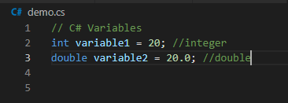
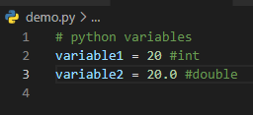
Variables
When it comes to variables in python, most languages use a type to state that it is a variable, python does not.
python automatically determines and assigns the data type to the variable:

Slide 11


Functions
The difference between Python and most languages in terms of functions / methods is python rather than using the typical curly brace approach, uses a “:” then indent approach.
For example:

Slide 12
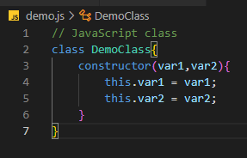
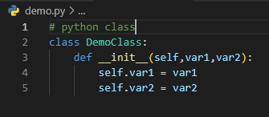
Classes
When it comes to using classes python is like most languages, it uses the ‘class’ keyword, followed by the class name.
For example:

Slide 13
Django Installation

Slide 14

Its as easy as 1,2,3
Once you have successfully downloaded the newest version of python, do the following:
Open your command prompt and navigate to where you want to store your project.
Enter the following command:
This will essentially create a virtual environment
Finally, enter:
Notes:
Once you have successfully downloaded the newest version of python, do the following:
Open your command prompt and navigate to where you want to store your project.
In my case I created a folder called Python_WorkSpace
Type the following command: (the name can be anything you like) py –m venv project_name
This tool provides isolated Python environments (or virtual environments), which are more practical than installing packages systemwide. It also allows installing packages without administrator privileges.
Finally, enter: python –m pip install Django

Slide 15
And that’s it!
You have successfully installed Django, and can now create any project using the framework!
Now lets put it to work!

Slide 16
Outside Reading and Documentation
Reference Links:
Python Documentation - https://www.python.org/
DJango Documentation - https://www.djangoproject.com/
DJango Introduction - https://developer.mozilla.org/en-US/docs/Learn/Serverside/Django/Introduction
DJango Setup – https://www.youtube.com/watch?v=eJdfsrvnhTE
Python Tutorial - https://www.youtube.com/watch?v=_uQrJ0TkZlc
Python DJango Tutorial - https://www.youtube.com/watch?v=rHux0gMZ3Eg
Django Tutorial - https://www.youtube.com/watch?v=OTmQOjsl0eg

